Slide 1


Apache Spark 2.1 Tutorial via Databricks Community Edition
Yao Yao and Mooyoung Lee
MSDS7330-403-Teaching-Presentation
https://spark.apache.org/images/spark-logo-trademark.png
https://spark-summit.org/2017/wp-content/uploads/sites/16/2017/03/databricks-logo.png

Slide 2
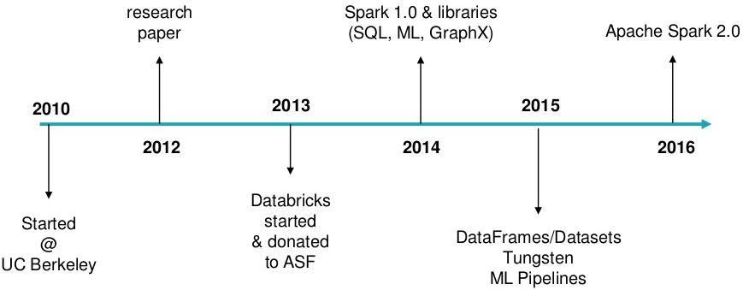
Timeline of Spark Development
Developed in 2009 at UC Berkeley’s AMPLab
Open sourced 2010 under BSD license
Top-contributed Apache project since 2014
https://www.slideshare.net/databricks/jump-start-with-apache-spark-20-on-databricks

Slide 3
What is Apache Spark?
Apache Spark is a fast and general engine for big data analytics processing with libraries for SQL, streaming, and advanced analytics.
Spark SQL + DataFrames
Streaming
MLlib
GraphX
Library Packages
Spark Core API
R
SQL
Python
Scala
Java
YARN
Stand Alone
Mesos
Databricks
https://www.linkedin.com/pulse/future-apache-spark-rodrigo-rivera

Slide 4
Spark Core API
Programming functionality, task scheduling
Resilient distributed datasets (RDDs) offers in-memory caching across cluster
Spark SQL + DataFrames
Streaming
MLlib
GraphX
Library Packages
Spark Core API
R
SQL
Python
Scala
Java
YARN
Stand Alone
Mesos
Databricks
http://www.kdnuggets.com/2016/03/top-spark-ecosystem-projects.html

Slide 5
Spark SQL + DataFrames
Wraps more coding infrastructure around SQL queries for more optimizations
spark.sql("SELECT * FROM Table").show()
Spark SQL + DataFrames
Streaming
MLlib
GraphX
Library Packages
Spark Core API
R
SQL
Python
Scala
Java
YARN
Stand Alone
Mesos
Databricks
https://docs.databricks.com/spark/latest/spark-sql/index.html

Slide 6
Structured Streaming
Combines streaming with batch and interactive queries for building end-to-end continuous applications
Spark SQL + DataFrames
Streaming
MLlib
GraphX
Library Packages
Spark Core API
R
SQL
Python
Scala
Java
YARN
Stand Alone
Mesos
Databricks
https://databricks.com/blog/2016/07/28/structured-streaming-in-apache-spark.html

Slide 7
Machine Learning Libraries
Consists of ML algorithms: classification, regression, clustering, collaborative filtering, and dimensionality reduction
Spark SQL + DataFrames
Streaming
MLlib
GraphX
Library Packages
Spark Core API
R
SQL
Python
Scala
Java
YARN
Stand Alone
Mesos
Databricks
http://spark.apache.org/docs/2.2.0/ml-guide.html

Slide 8
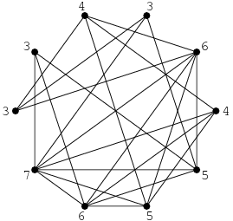
GraphX
Parallel computation for GraphFrames,
which handles vertex degrees such as page rank and social networking
Spark SQL + DataFrames
Streaming
MLlib
GraphX
Library Packages
Spark Core API
R
SQL
Python
Scala
Java
YARN
Stand Alone
Mesos
Databricks
http://mathworld.wolfram.com/VertexDegree.html http://spark.apache.org/docs/2.2.0/graphx-programming-guide.html

Slide 9
Import Custom Library Packages
Includes the ability for you to install custom libraries to the Spark Core API by attaching them to the cluster
Spark SQL + DataFrames
Streaming
MLlib
GraphX
Library Packages
Spark Core API
R
SQL
Python
Scala
Java
YARN
Stand Alone
Mesos
Databricks
https://databricks.com/blog/2015/07/28/using-3rd-party-libraries-in-databricks-apache-spark-packages-and-maven-libraries.html

Slide 10
Cluster Manager
Current tutorial uses online Databricks cluster manager. Spark can also run with Hadoop’s YARN, Mesos, or as a stand alone
Spark SQL + DataFrames
Streaming
MLlib
GraphX
Library Packages
Spark Core API
R
SQL
Python
Scala
Java
YARN
Stand Alone
Mesos
Databricks
http://www.agildata.com/apache-spark-cluster-managers-yarn-mesos-or-standalone/

Slide 11
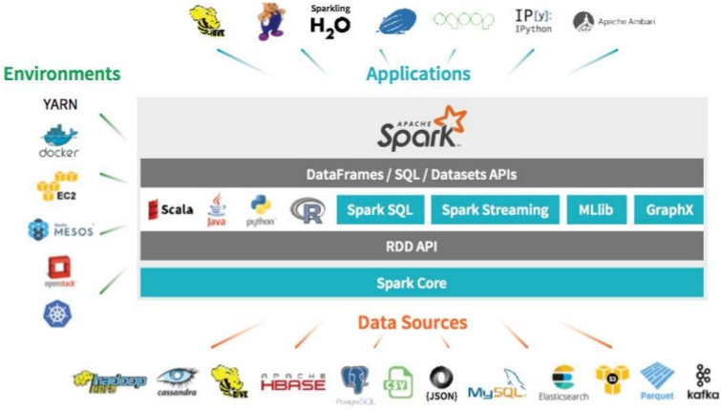
Unified Analytics Integrations
Can be integrated with diverse environments, applications, and data sources
https://www.slideshare.net/databricks/jump-start-with-apache-spark-20-on-databricks

Slide 12
Cloud Computing on Databricks
Go to http://community.cloud.databricks.com/
Create a free community account (No computing fees)
Create a cluster and select the Spark version
Create a notebook and select programming language
To change languages within a cell:
%scala for scala
%sql for sql
%r for r
%python for python
%md for markdown
Able to purchase multiple clusters for running parallel jobs
Mitigates load time and frees up your local machine

Slide 13
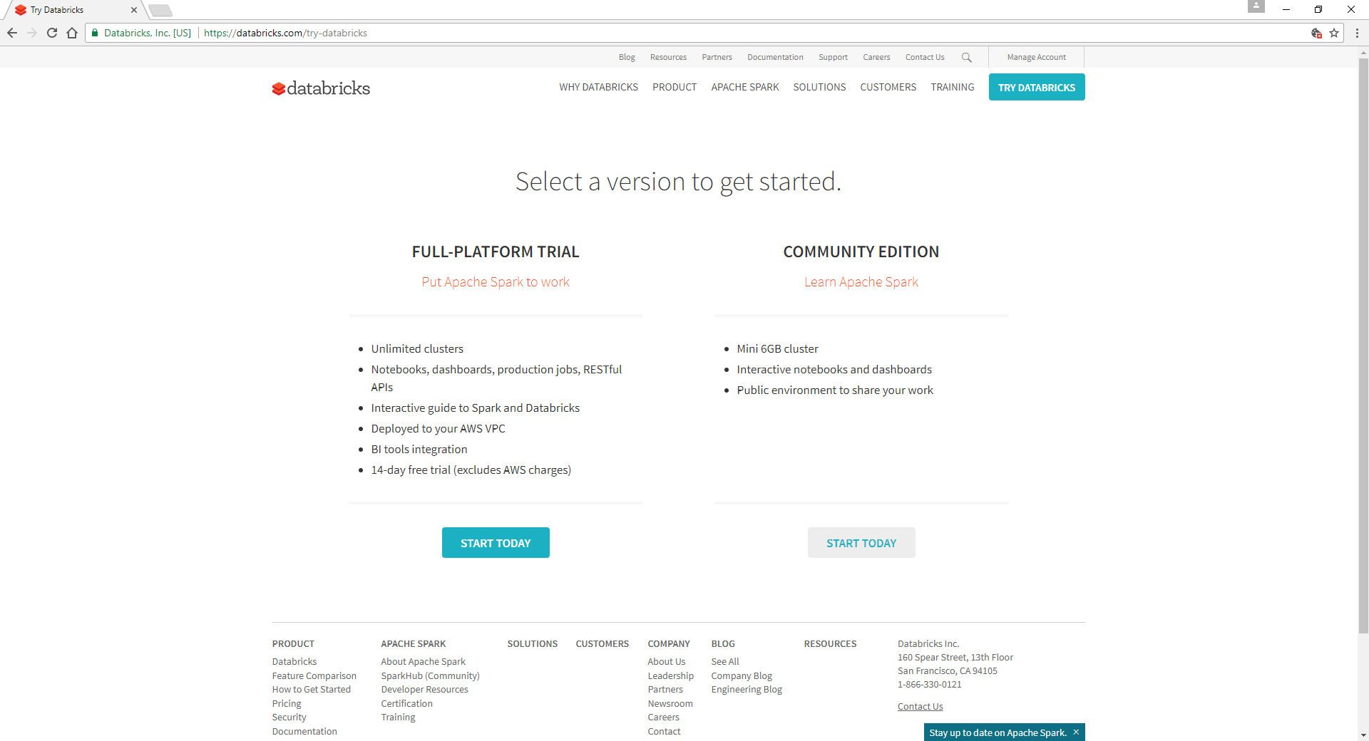
http://community.cloud.databricks.com/
Notes:
https://databricks.com/product/pricing/instance-types

Slide 14
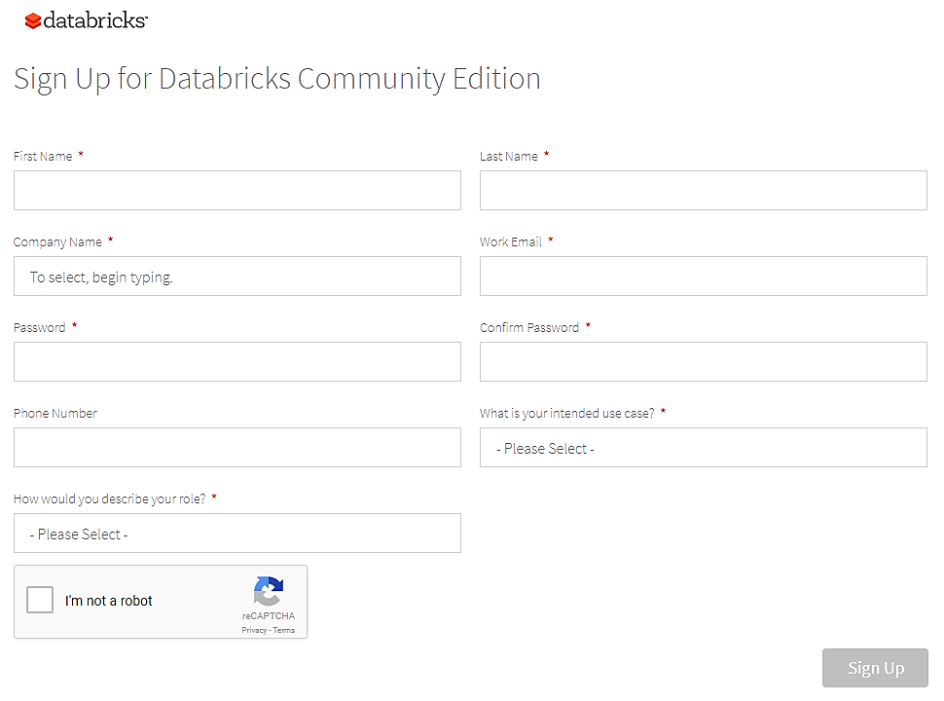
http://community.cloud.databricks.com/

Slide 15


Workspace allows you to save notebooks and libraries.
Notebooks are a set of any number of cells that allow you to execute commands.
Dashboards can be created from notebooks as a way of displaying the output of cells without the code that generates them.
Libraries are packages or modules that provide additional functionality that you need to solve your business problems. These may be custom written Scala or Java jars, Python eggs, or custom written packages.
Data is where datasets are uploaded and stored on the Databricks File Storage
Clusters are groups of computers that you treat as a single computer. In Databricks, this means that you can effectively treat 20 computers as you might treat one computer. (Paid Subscription for more clusters)
Jobs are scheduled for execution to occur either on an already existing cluster or a cluster of its own. These can be notebooks as well as jars or python scripts. (Paid Subscription for scheduled jobs)
Apps are third party integrations with the Databricks platform. These include applications such as Tableau.
http://community.cloud.databricks.com/

Slide 16
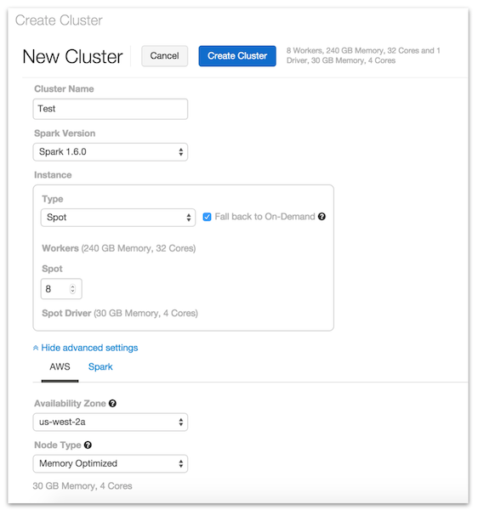
Creating a Cluster
Select a unique name for the cluster.
Select the Spark Version.
Enter the number of workers to bring up - at least 1 is required to run Spark commands.
Select and manage additional options.
http://community.cloud.databricks.com/

Slide 17
Demo 1: Databricks Basics
Loading In Dataset and Library
Revision History
Commenting
Dashboard
Publishing
Github (paid subscription)
Collaborations (paid subscription)
Online notebook has better visualizations than the local install

Slide 18
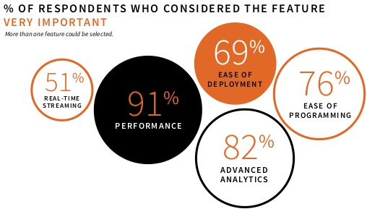
Addressing Today’s Challenges
CPU speed
End-to-end applications using one engine
Decision implementation based on real-time data
https://www.slideshare.net/abhishekcreate/2016-spark-survey

Slide 19
Challenge 1: Hardware Trends
 | 2010 | 2017
Storage | 100 MB/s (HDD) | 1000 MB/s (SSD)
Network | 1 GB/s | 10 GB/s
CPU | ~3 GHz | ~3 GHz
Storage capacity and network increased by 10-fold
CPU speed remained relatively the same
To accommodate for the CPU speed:
We are close to the end of frequency scaling for CPU, where the speed cannot run more cycles per second without using more power and generating excessive heat.
Hardware manufacturers have created multiple cores for parallel computing processing, which requires a form of MapReduce to compensate for distributed computation
https://www.slideshare.net/databricks/spark-summit-east-2017-matei-zaharia-keynote-trends-for-big-data-and-apache-spark-in-2017

Slide 20
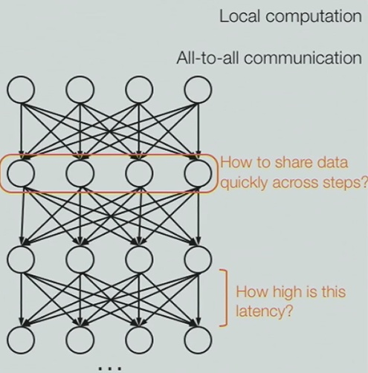
MapReduce
“Map" is the transformation step for local computation for each record
“Shuffle" is the synchronization step
“Reduce" is the communication step to combine the results from all the nodes in a cluster.
Executes in sequence, where jobs are high-latency (slow) and no subsequent job could start until the previous job had finished completely
https://www.youtube.com/watch?v=y7KQcwK2w9I http://vision.cloudera.com/mapreduce-spark/

Slide 21
Spark’s Alternative to MapReduce
Instead of records, uses column ranges
Retains schema model for indexing, which could be read inside MapReduce records
Uses an alternative multi-step Directed Acyclic Graphs (DAGs)
mitigates slow nodes by executing nodes all at once and not step by step and eliminates the synchronization step, which lowers latency (faster)
Supports in-memory data sharing across DAGs, so different jobs can work with the same data at very high speeds
http://vision.cloudera.com/mapreduce-spark/

Slide 22
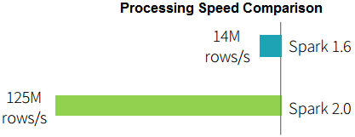
Project Tungsten for Spark 2.0
Mitigates runtime code generation
Removes expensive iterator calls
Fuse multiple operators
Binary conversion and complies to pointer arithmetic (user codes efficiently while performance is increased)
Dataframe code | df.where(df("year") > 2015)
Logical expression | GreaterThan(year#345, literal(2015))
Java Bytecode | bool filter(Object baseObject) { int offset = baseOffset + bitSetWidthInBytes + 3*8L; int value = Platform.getInt(baseObject, offset); return value > 2015;}
https://www.slideshare.net/databricks/spark-summit-east-2017-matei-zaharia-keynote-trends-for-big-data-and-apache-spark-in-2017 http://vision.cloudera.com/mapreduce-spark/

Slide 23
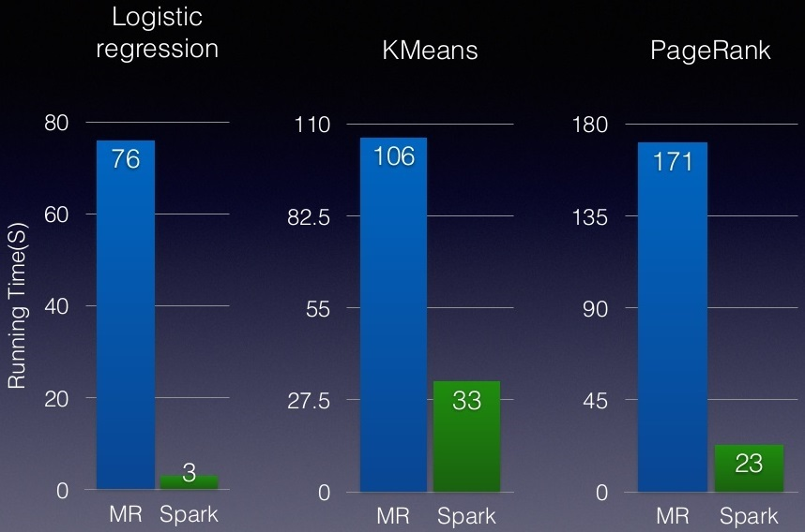
Demo 2: CPU Speed
Sc parallelize word count
Linear regression
GraphX
Speed Comparison between MapReduce and Spark
https://www.slideshare.net/databricks/2015-0317-scala-days
Spark is 3 to 25 times faster than MapReduce

Slide 24
Challenge 2: Specialized Engines
More systems to install, configure, connect, manage, and debug
Performance dwindles because it is hard to move big data across nodes and dynamically allocate resources for different computations
Writing temp data to file for another engine to run analysis slows down processes between systems
https://www.youtube.com/watch?v=vtxwXSGl9V8

Slide 25
End-to-End Applications
Able to switch between languages, implement specific libraries, and call on the same dataset in the same notebook
Data sets could be cached in RAM while implementing different computations
High level APIs allow for vertical integration
Performance gains are cumulative due to the aggregation of marginal gains
https://community.cloud.databricks.com/?o=7187633045765022#notebook/418623867444693/command/418623867444694

Slide 26
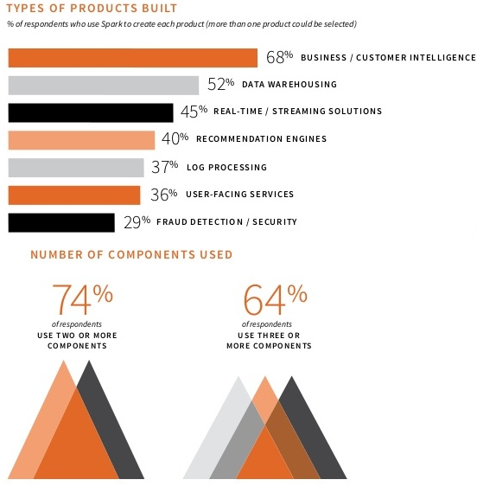
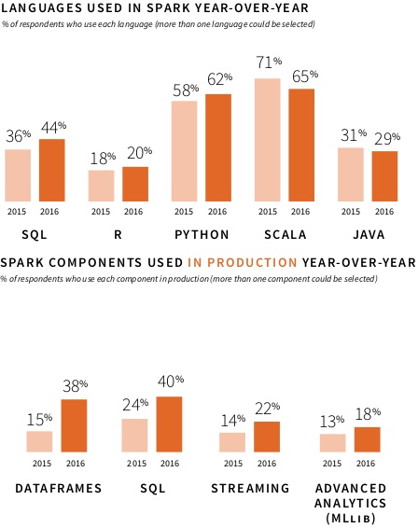
Diversity in Application Solutions and Methods
https://www.slideshare.net/abhishekcreate/2016-spark-survey

Slide 27
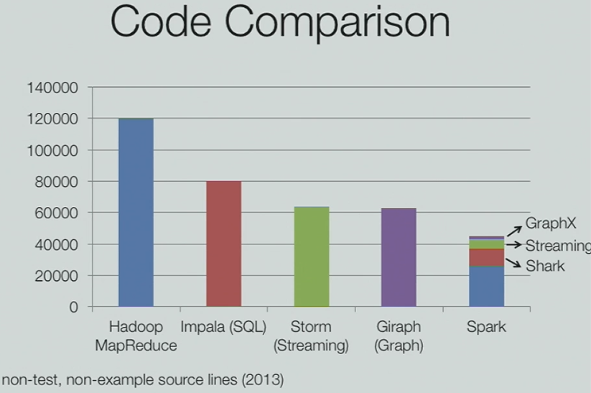
Demo 3: End-to-End Applications
Changing Languages for the best models and applications
Producing visualizations
Spark SQL
JSON Schema
https://www.youtube.com/watch?v=y7KQcwK2w9I

Slide 28
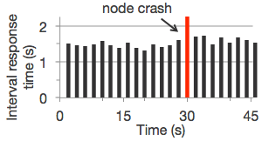
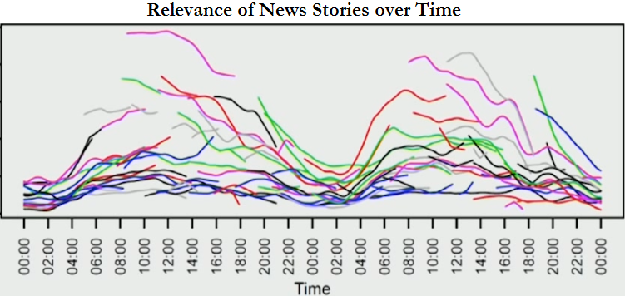
Challenge 3: Decisions Based on Data Streaming
Streamed data may not be reliable due to:
Node crashes
Asequential data
Data inconsistency
https://www.youtube.com/watch?v=KspReT2JjeE
https://spark.apache.org/streaming/

Slide 29
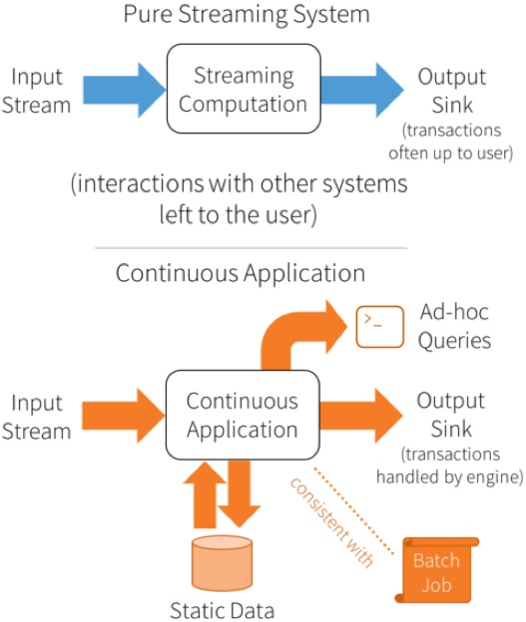
Structured Streaming / Node Indexing
Fault tolerance fixes node crashes
Special filtering fixes asequential data
Indexing fixes data consistency
Ad-hoc queries on top of streaming data, static data, and batch processes would allow more flexibility in the real-time decision making process
https://databricks.com/blog/2016/07/28/structured-streaming-in-apache-spark.html

Slide 30
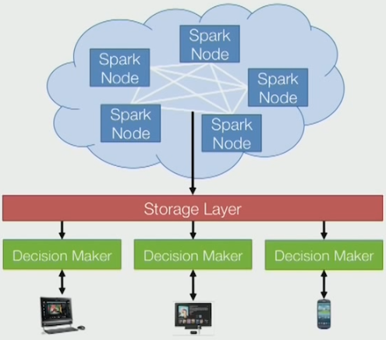
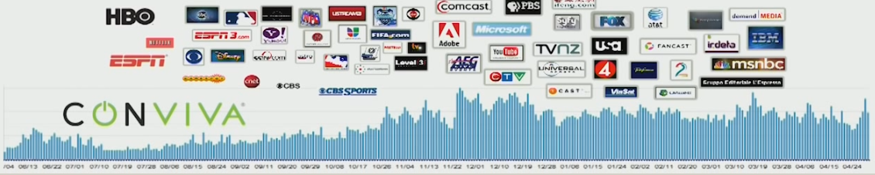
Real-Time Solutions from the Cloud
Personalized web results
Automated stock trading
Trends in news events
Credit card fraud prevention
Video quality optimization by dynamically selecting server sources
https://www.youtube.com/watch?v=KspReT2JjeE

Slide 31
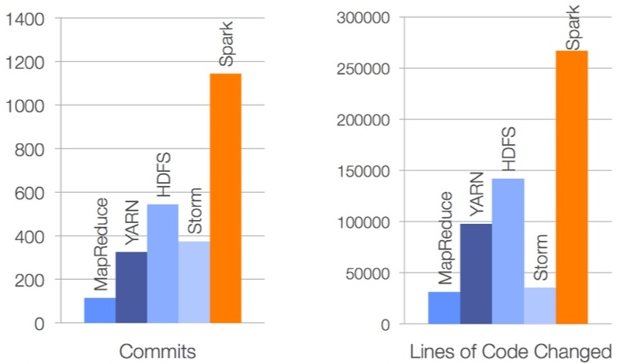
Demo 4: Data Streaming
Streaming
Library Packages
Custom Applications
Spark Leads in number of Contributors
https://www.slideshare.net/databricks/unified-big-data-processing-with-apache-spark-qcon-2014

Slide 32
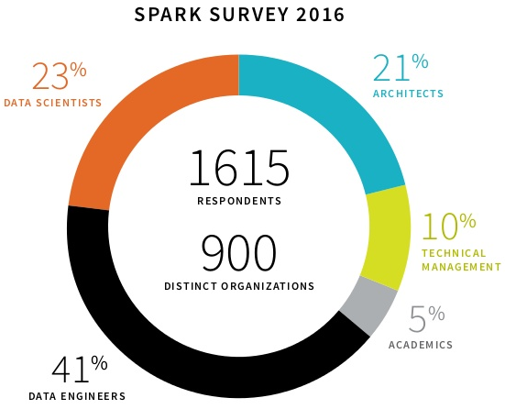
Conclusion
Diversity of organizations, job fields, and applications that use Spark will continue to grow as more people find use in its various implementations
Spark continues to dominate the analytical landscape with its efficient solutions to CPU usage, end-to-end applications, and data streaming
https://www.slideshare.net/abhishekcreate/2016-spark-survey

Slide 33
Learn/Teach Apache Spark 2.1 via Databricks Community Edition
Lynda:
Essential Training: https://www.lynda.com/Apache-Spark-tutorials/Apache-Spark-Essential-Training/550568-2.html
Extending Spark: https://www.lynda.com/Hadoop-tutorials/Extending-Hadoop-Data-Science-Streaming-Spark-Storm-Kafka/516574-2.html
IBM bigdatauniversity:
Spark Fundamentals I: https://courses.cognitiveclass.ai/courses/course-v1:BigDataUniversity+BD0211EN+2016/info
Spark Fundamentals II: https://courses.cognitiveclass.ai/courses/course-v1:BigDataUniversity+BD0212EN+2016/info
Apache Spark Makers Build: https://courses.cognitiveclass.ai/courses/course-v1:BigDataUniversity+TMP0105EN+2016/info
Exploring Spark's GraphX: https://courses.cognitiveclass.ai/courses/course-v1:BigDataUniversity+BD0223EN+2016/info
Analyzing Big Data in R using Apache Spark: https://courses.cognitiveclass.ai/courses/course-v1:BigDataUniversity+RP0105EN+2016/info
completed notebooks: files found from notebook root
O'Reilly:
Definitive Guide Excerpts: http://go.databricks.com/definitive-guide-apache-spark
Raw Chapters: http://shop.oreilly.com/product/0636920034957.do
Databricks:
Educational and Training material: https://docs.databricks.com/spark/latest/training/index.html
Community edition github: https://github.com/databricks/Spark-The-Definitive-Guide
Github:
https://github.com/yaowser/learn-spark

